Slide 1
TECH INNOVATION PITCH 2026 • CS & IT CATEGORY
Child Safety Tracker System
Integrated Wearable BLE Band, Mobile Safe-Zone Alerts, Web Analytics & Data Mining Anomaly Detection
PROJECT SCOPE
PROTOTYPE TARGET
Hardware + Mobile + Web + AI
Affordable Academic Validation

Slide 2



01. PROBLEM IDENTIFICATION
Child Safety & Monitoring Challenges
Unmonitored Movements
Delayed Emergency Reaction
High Commercial Cost
Parents lose visual contact when children drift outside familiar safe areas in public spaces.
Immediate status and tamper notifications are absent in traditional non-connected safety accessories.
Existing cellular GPS trackers are expensive, complex, and require monthly subscription fees.

Slide 3




02. TARGET BENEFICIARIES
Who Faces The Problem?
Parents & Guardians
Schools & Early Care
Seeking a low-cost, intuitive solution for real-time proximity alerts during outdoor activities.
Childcare centers needing centralized roster tracking and out-of-bounds safety logs.
Budget-Conscious Families
Academic Evaluators
Ordinary households requiring reliable hardware safety without expensive telecom plans.
Controlled testing environment for sensor data mining and BLE distance modeling.

Slide 4

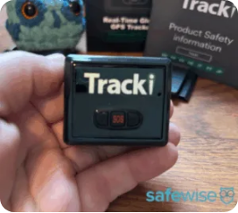
03. PROPOSED SOLUTION
Wearable Band + Smart App + AI Platform
Lightweight BLE Tracker Band
Ergonomic medical-grade silicone band with BLE 5.2, panic SOS button, and removal detection sensor.
Parent Mobile Application
Configurable safe-zone boundaries, instantaneous breach alerts, and device status pairing.
Web Analytics & AI Engine
Data mining algorithms detecting unusual movement patterns and risk behavior flags.

Slide 5




04. SYSTEM ARCHITECTURE
How The Ecosystem Works
1. Wearable Band
2. Mobile App
3. Cloud Backend
4. AI Web Portal
BLE 5.2 Beacon + Tamper Sensor + SOS
Proximity Detection & Real-time Alerting
Secure Event Logging & Sync Database
Data Mining & Risk Pattern Analytics
Proximity Workflow: Continuous BLE handshake verifies distance. Safe-zone violation triggers immediate sound/vibration alerts on the mobile app within 2 seconds.

Slide 6
05. TECHNOLOGY STACK
Required Hardware & Software Components
HARDWARE LAYER
MOBILE & SOFTWARE
BLE 5.2 & Microcontroller
Cross-Platform Application
Microcontroller: ESP32-C3 / nRF52840 Module
App Framework: Flutter / React Native BLE stack
Battery: Sealed Li-Po Micro-Battery (3.7V)
Backend: Node.js / Python Fast-API Service
Enclosure: 38x22mm Child-Proof Silicone Casing
Database: PostgreSQL / Firebase Realtime DB
WEB ANALYTICS
AI & DATA MINING
Management Dashboard
Anomaly Analytics
Frontend: React.js / TailWind Dashboard UI
Data Mining: Scikit-learn / Cluster Pattern Mining
Visualizations: Real-time Event Map & Log Charting
Model Scope: Abnormal-Movement & Outlier Detection

Slide 7
06. FEASIBILITY JUSTIFICATION
Why Is This Project Feasible For Students?
Technical Feasibility
Financial Practicality
Manageable Scope
Uses standard off-the-shelf BLE components and established open-source mobile libraries. Does not require complex custom silicon manufacturing.
Estimated prototype hardware bill-of-materials is low cost, making it highly affordable for student lab development and iteration.
Focuses initially on local BLE proximity and dataset-driven AI validation before attempting complex cellular telecom integrations.

Slide 8

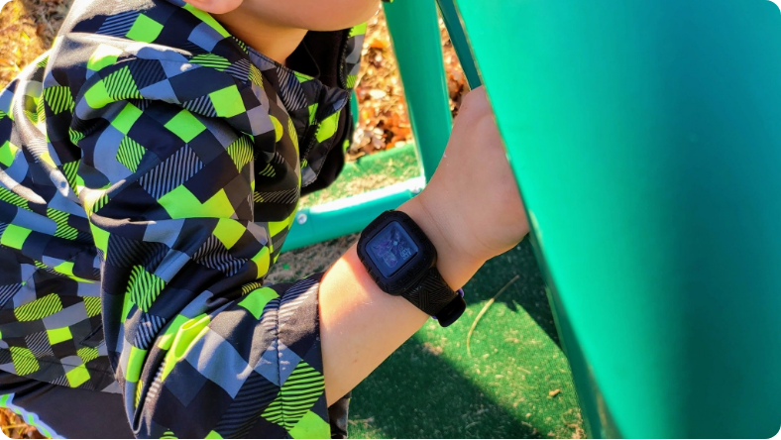
07. EXPECTED IMPACT
Real-World Benefits & Value Proposition
Immediate Peace of Mind
Instant feedback when a child wanders beyond set proximity limits.
Affordable Safety Access
Democratizes child monitoring technology without subscription barriers.
Data-Driven Insights
Provides historical safety logs and movement pattern analytics for child safety research.

Slide 9
08. EXECUTION BOUNDARIES
Initial Prototype vs. Future Scope
Phase 1: Initial Scope
ACADEMIC MVP
Phase 2: Future Scope
COMMERCIAL EXPANSION
Compact BLE 5.2 Smart Tracker Hardware
GPS + Cellular Emergency Wide-Area Mode
Parent Mobile App Proximity Pairing
Advanced Miniaturization & Waterproofing
Web Platform Management & Dashboard
Public Safety & School Board Partnerships
Baseline Data Mining Anomaly Detection
Full Regulatory & FCC Safety Certifications

Slide 10
09. RISK MANAGEMENT
Technical Challenges & Validation
Battery & Thermal Safety
BLE Proximity Noise
Challenge: Heat dissipation & micro-battery safety near skin.
Mitigation: Medical-grade casing, thermal protection circuitry validated from -5°C to 45°C.
Challenge: Signal fluctuations due to physical obstacles.
Mitigation: RSSI signal smoothing algorithms to eliminate false breach alarms.
Data Privacy & Security
AI Model Boundary
Challenge: Responsible handling of child status records.
Mitigation: End-to-end encrypted BLE handshake and strict local device authentication.
Challenge: Realistic AI performance boundaries.
Mitigation: AI acts as decision support for anomalous movement; non-deterministic claims avoided.

Slide 11
10. EXECUTION ROADMAP
Phased Development Timeline
1
2
3
4
5
Requirements & Hardware
BLE Tracker Prototype
Mobile & Web App
AI Data Integration
Testing & Results
Firmware, BLE handshake, tamper button
Alert UI, backend database, admin portal
External datasets + anomaly mining models
Controlled validation and FYP documentation
Circuit design, casing specs, thermal testing

Slide 12
SUMMARY & FINAL PITCH
Child Safety Tracker System
An end-to-end, affordable hardware + mobile app + AI system delivering real-time safety, practical student feasibility, and strong research potential.
Thank You! Open for Questions

Slide 13


Image Sources
https://www.safewise.com/app/uploads/2026/01/Tracki-GPS-Tracker-2-300x269.webp
Source: www.safewise.com
https://cdn.mos.cms.futurecdn.net/5YnhfmSCLsvg5VhGEGigoh.jpg
Source: www.androidcentral.com

